Slide 1

What is a Blockchain?
Presented by: [Name] @[twitter handle]
Part of the Ethereum 101 Series: www.ethereum101.org

Slide 2
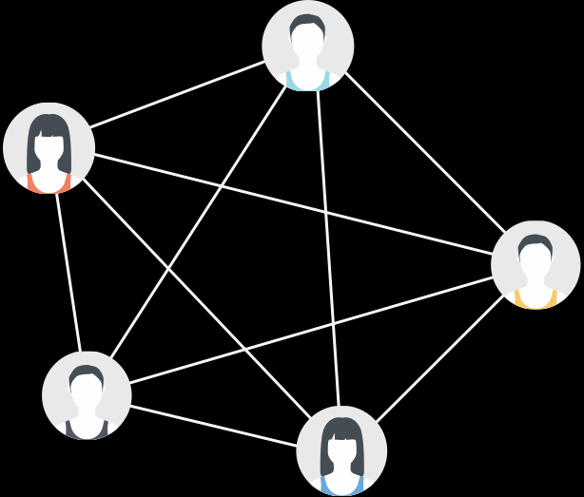

In cryptocurrency systems each account has a balance, but there is no physical token to hold.

Slide 3
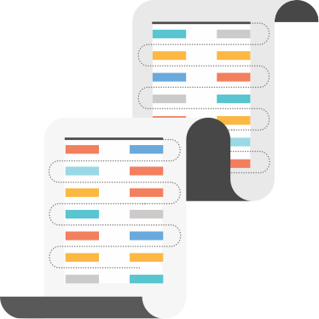
Blockchains serve as a foundation for decentralized agreement on what those balances are.

Slide 4

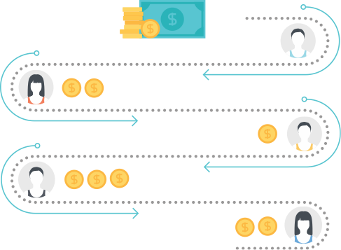
It is the shared, collective history of transactions on the network.

Slide 5

The blockchain and its transactions are fully public and may be audited by anyone.

